Slide 1
PSG 11 Timeline Assessment Exercise – Europa-UVS
Tracy Becker, Shawn Brooks, Kurt Retherford

Slide 2
Feedback/Assessment
We are looking for feedback in three areas (that are in alignment with the goals of this exercise: team education, opportunities, refine our design).
[Team Education] Feedback (likely narrative) on the standard template and the timelines in general. Questions a team member might ask themselves:
Do I understand all the opportunities in the tour that have been realized for the science and perhaps more importantly, the ones that have not?
Are these opportunities sufficient to achieve the intended science?
[Opportunities] Are there specific changes (something that could be described with start and stop times etc.) that were noted. We have created a spreadsheet for that type of feedback
PSG11 Timeline Assessment Exercise Investigation — Timeline Improvements.xlsx
[Refine our Design]. This is our first time through and there are likely a lot of good ideas out there for better products/tools
Are there are products that would be useful in the future activity timeline review?
Are there are changes to the look and feel of any of the output products that you would find beneficial?

Slide 3
What is the Project Looking For?
Looking at the existing tools to determine whether they are sufficient for assessing a tour

Slide 4
What tools do we have?
Europa SIM Reports Stacked Plots --- this is good for high level overview of activities

Slide 5
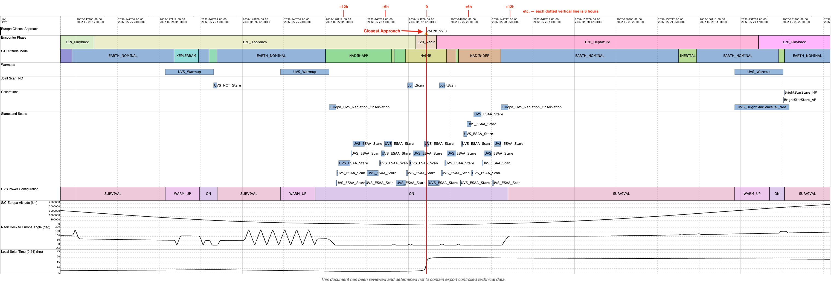
What tools do we have: Raven
Very Slow
Issues / bugs caught already (thanks Shawn!)
Hard to access outside of JPL
Does not provide universal view of what other instruments are doing
Difficult to understand what is driving off-nadir activity

Slide 6
Timeline Assessment – Europa-UVS
This is our first time through a timeline assessment, please feel free to use a format that makes the most sense for your feedback - we are very flexible
The Investigation Teams assessment of the standard template and the activity timelines as they exist now
Comments/narrative (this is the bread and butter of the exercise)
It is difficult to assess how we know the details of the UVS activities without the tool/GUI that is in development to do so.
We will want to be able to see the activity parameters that got set (based on the activity definitions being designed now) as a hover-over or some simple format along the timeline of activities to make sure the activity is defined the way it was expected
Ultimately, Europa-UVS would want a way to export not only the view of what the spacecraft is doing, but also the configuration of the instrument itself based on the activity planning inputs we’re in the process of providing to the project. This would allow us to:
assess with our own tools that the flyby is optimized for science and data volume, etc.,
make changes that we can then submit back to Merlin (see Slide 8)
For future assessments, it would be beneficial for Europa-UVS if a more complex flyby that includes occultations, transits, etc. were selected

Slide 7
Timeline Assessment – Europa-UVS
Positive Aspects (e.g. as expected, robustness, etc.):
The packets with the stacked plots are useful as quick reference guides for overview of activities
Orbit in the Life diagrams are a good start for seeing the overview of the activities, and we look forward to seeing future iterations that include the UVS investigations’ observations, calibrations, opportunities, etc.
Negative Aspects (e.g. not as expected, not sufficient to achieve intended science):
It would be helpful for the tool to produce a clear understanding of what is motivating changes in the s/c pointing so that opportunities for synergistic observations could be made. For example, which events are ECM rolls, scans, calibration slews, etc. Some of these events are not time adjustable, but others might be, and that would be helpful to know when assessing each flyby.
With the current set of tools, we cannot identify if/when MISE or EIS are targeting a specific location on the surface, which is information that would benefit Europa-UVS.
RAVEN is very slow, we’ve identified a few bugs, and we need more customizable capabilities
Europa-UVS timeline as shown in the Timeline Assessment kick-off package does not correspond to the RAVEN view one gets when attempting to go to the RAVEN URL specified in the package.

Slide 8
Useful feedback on tools or outputs – Europa-UVS
New products or tools that would be useful?
Easy accessibility to a detailed timeline of what activity is being executed by Europa-UVS (like uvsopmode file) with each tour or tour tweak would be beneficial.
Ability to view other non-UVS activities
A simple reference for the times of the start/stop of each orbit, in addition to the C/A time would be helpful
Having a rough idea for how RAVEN interfaces with the E-GAS tool would be useful at this time, e.g., showing the points in time when regions of interest are observed/crossed
Changes to existing products or tools that would be beneficial?
Would be good to have a way to identify mutual events with Jupiter or other satellites within Raven
Other tools we are using (see following slides)
GeoVis
Europa-UVS Observation Planning Tool

Slide 9
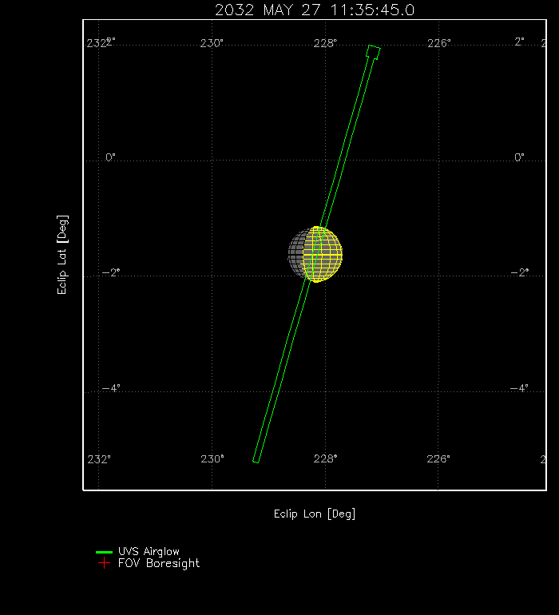
GeoVis (GV)
Flyby E20
A visualization like this one quickly identifies a unique opportunity with the Io transit that may have otherwise not been obvious with current tools

Slide 10
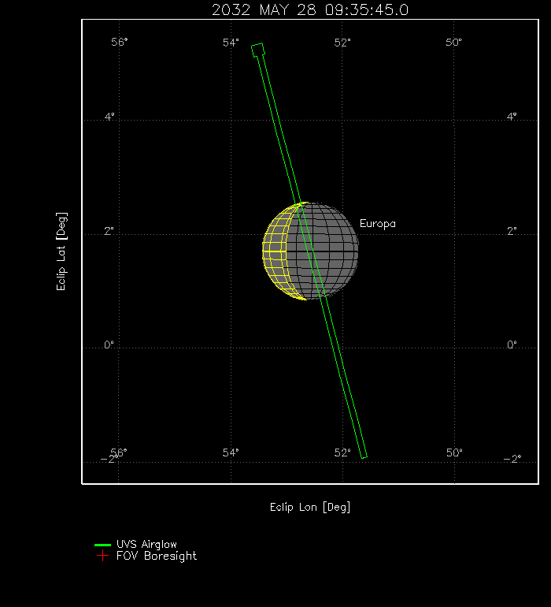
GeoVis (GV)
Flyby E20: Io Transit

Slide 11
Europa-UVS Timeline Assessment
What UVS is imagining for flow of timeline assessment:
The tour design sets up when UVS observations occur (stares, occultations, transits, neutral cloud/torus stares, scans)
Merlin uses activity definitions to set how the instrument operates for the planned times UVS is operating
Within Merlin or an added GUI, we can see the observations on a timeline and be able to hover/click to see details of the activity definition at any time
We can then export the timeline and defined activities (in a format like a CSV) that we can upload to our tool (see next slide) so we can do a detailed assessment, make changes within the activity (e.g., change spectral/spatial resolution), then output our new activity definitions across the timeline for input back into Merlin for execution/data volume review.

Slide 12
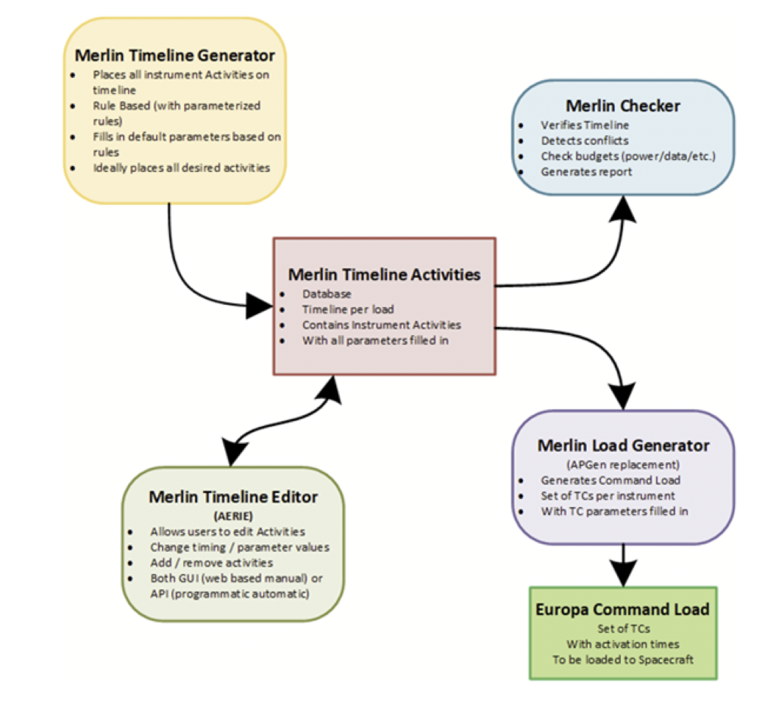
Flow of commanding for UVS
Unclear the overall expected flow of planning the commanding for the investigations
Since Merlin does not yet exist, very difficult to assess how interacting with this tool will work
Figure by Maarten and Sue

Slide 13
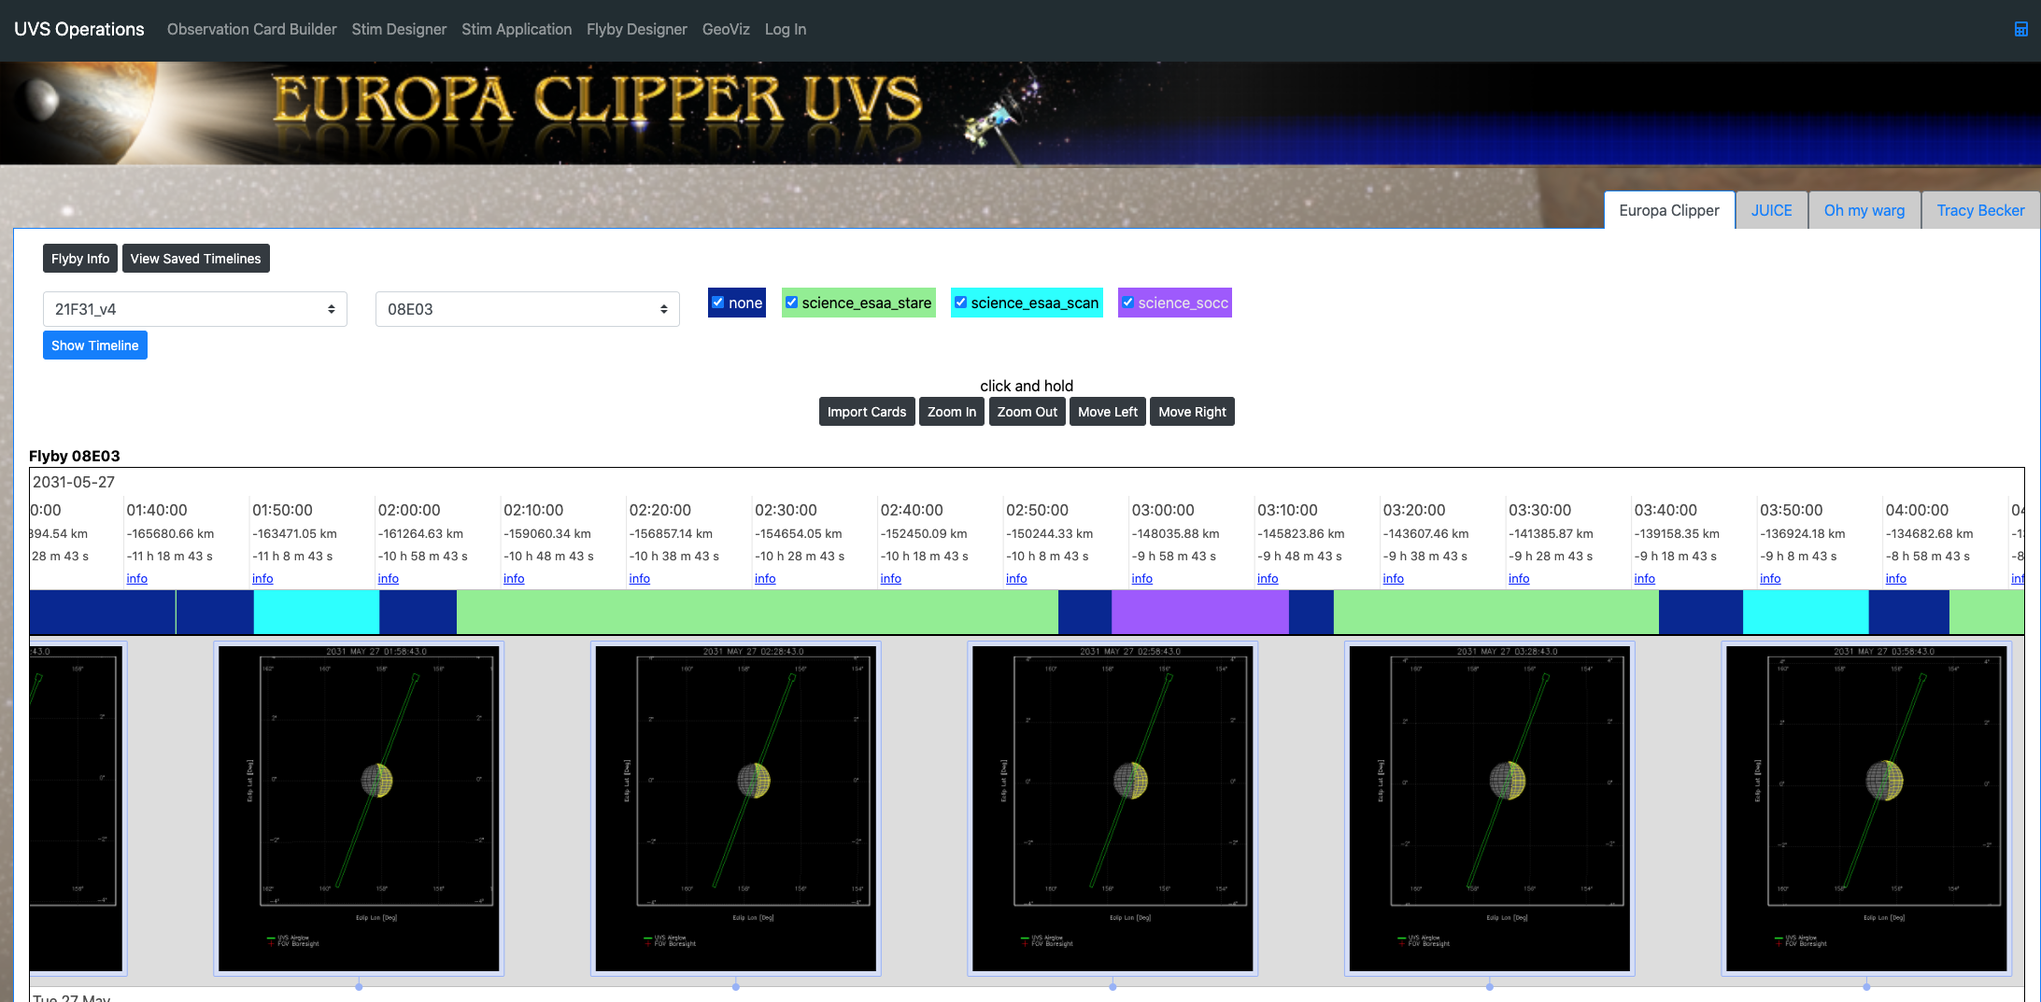
Europa-UVS Observation Planning Webtool
Tour & Flyby Info
The different observations as currently provided in uvsopmode file

Slide 14
Europa-UVS Observation Planning Webtool
Tour & Flyby Info
The different observations as currently provided in uvsopmode file

Slide 15
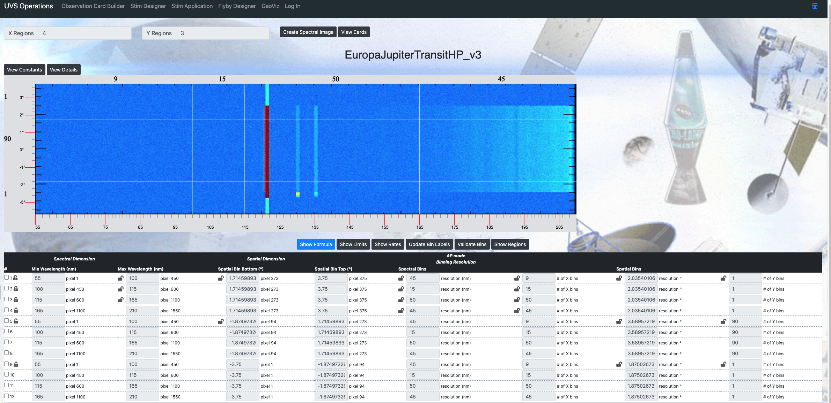
Europa-UVS Observation Planning Webtool
We build an “observation card” with the exact spectral and spatial resolutions needed for the observation
Number of bins in this spectral range
Spatial
Number of bins in this spatial range
Spectral

Slide 16
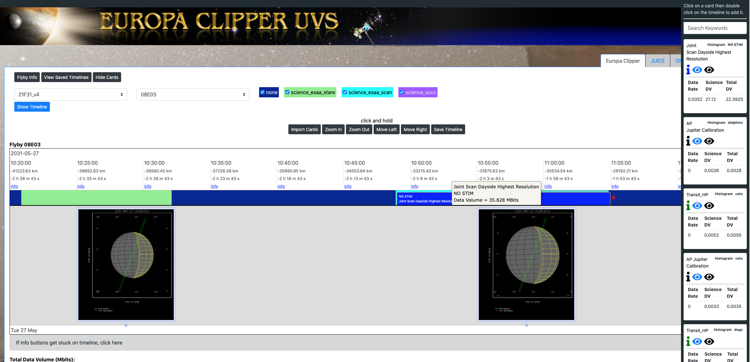
Europa-UVS Observation Planning Webtool
List of all of the cards we’ve developed to be placed on the timeline. We can edit these quickly with new activity definitions for special cases.
We can place the cards on the timeline. Date volume updates real-time as we make the observation longer or shorter (info provided when hovered).

Slide 17
Europa-UVS Observation Planning Webtool
Ideally, we could take the output from Merlin to populate this timeline automatically with the current activity set up for each flyby. Then we could see within our tool what we might want to change and the effects of those changes, before outputting those changes in a way that Merlin could then use as new inputs.

Slide 18
Feedback on specific changes to the tour
Who | Description of Improvement | Time Period | If known, affected subsystems/inveestigations | Rationale/Justification
Europa-UVS | On E20 there is a mutual event with Io | E20
Europa-UVS | Operate Europa-UVS during MAG Rolls | Full Tour

Slide 20
Bring up timeline for specific flyby load
Geometric events line in Raven?
“Designate” the “prime” activities that can be loaded in a panel so we can better see what is driving changes on the s/c
Could probably do a slew scan observation when E-THEMIS slews off to do a space stare calibration

